Slide 1
MICROSOFT AZURE
PHANI KISHORE LANKA

Slide 2
Course Content
Understanding Cloud Computing Basics
Azure Overview & Understanding Azure Services
Chapter 1 → Azure Storage
Chapter 2 → Azure Network
Chapter 3 → Azure Compute
Chapter 4 → Azure App Services
Chapter 5 → Azure Databases
Chapter 6 → Azure Big Data
Chapter 7 → Azure EAI (Enterprise Application Integration)
Chapter 8 → Azure IOT (Internet of Things)
Chapter 9 → Azure Security
Chapter 10 → Azure Automation

Slide 3
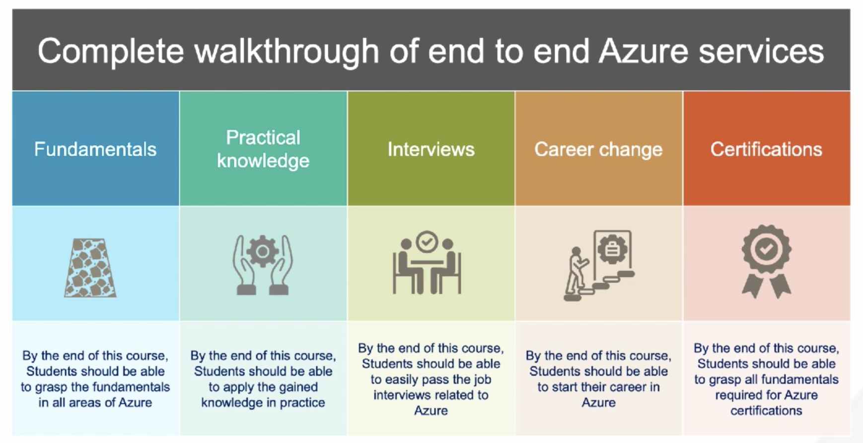
Outcome of Course

Slide 4
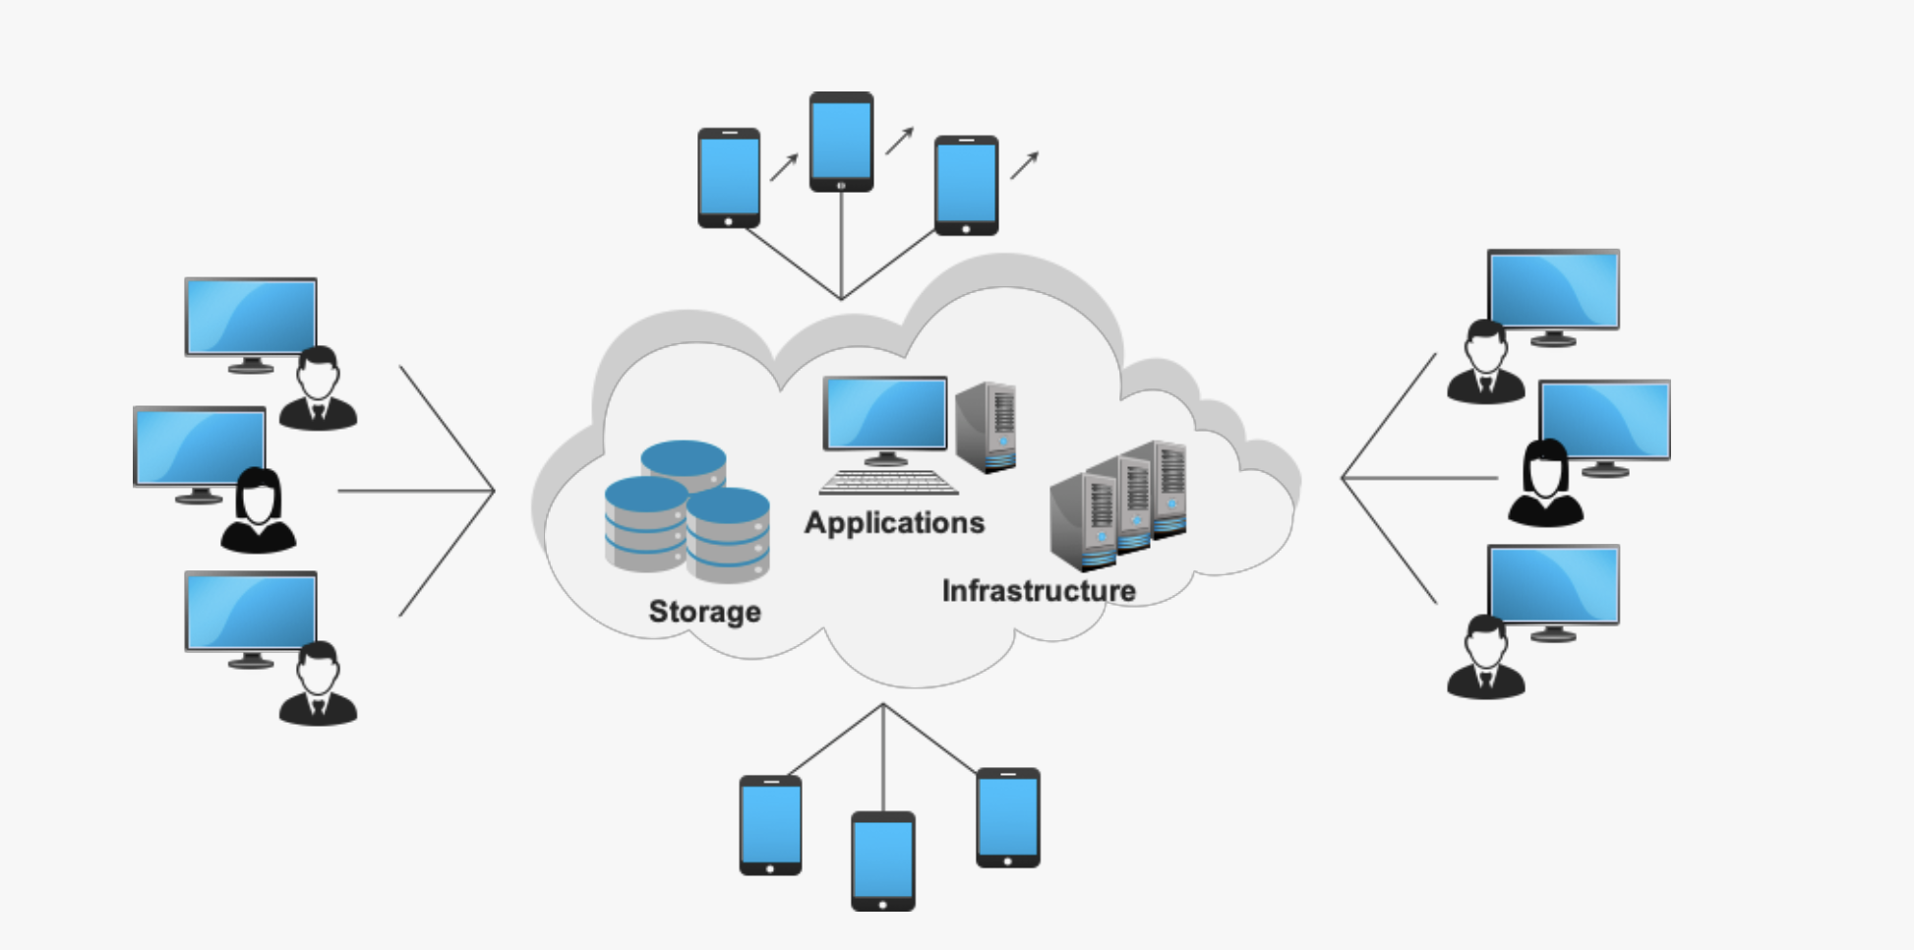
Cloud Computing
Cloud Computing is the Delivery of Computing Services – Servers, Storage, Network,
Software , Analytics , Intelligence and more over the Internet (“THE CLOUD”)
Companies that offer these services are called Cloud Providers (AWS/Azure/GCP/OCI/IBM)
Typically Cloud Computing Services will be charged based on Usage (PAY AS YOU GO MODEL)

Slide 5
Benefits of Cloud Computing
COST - Hugely Reduce Captial Costs for Buying H/w & S/w
SPEED – Resources can be provisioned in Minutes with few mouse clicks
SCALABILITY – Resources can be scaled up and down with in mins according to Business Requirements.
PRODUCTIVITY – Cloud Computing Takes out H/w Setup, Patching etc, so IT Team can focus on Achieving Business Goals.
RELIABILITY – Cloud Computing makes Data Backup , DR & Business Continuity Less expensive and faster Recovery.
SECURITY – Various Security Levels, Various Policies/Technology Based Controls that strengthen Security Posture Overall.

Slide 6
Types of Cloud Computing
Public Cloud - Public clouds are owned and operated by a third-party cloud service provider, which delivers computing resources such as servers and storage over the Internet.
Private Cloud – Private cloud refers to cloud computing resources used exclusively by a single business or organization. A private cloud can be physically located on the company’s on-site datacenter. Some companies also pay third-party service providers to host their private cloud.
Hybrid Cloud - Hybrid clouds combine public and private clouds, bound together by technology that allows data and applications to be shared between them. hybrid cloud gives businesses greater flexibility and more deployment options.

Slide 7
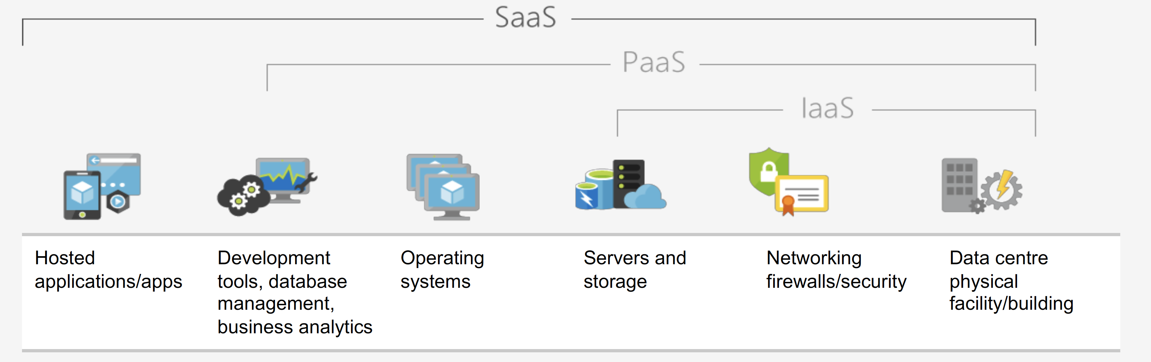
Models
Infrastructure as Service (IAAS) - With IaaS, you rent IT infrastructure - servers and
virtual machines (VMs), storage, networks, operating systems from a cloud provider
on a pay-as-you-go basis
2. Platform as a Service (PAAS) – Platform as a service (PaaS) refers to cloud computing
services that supply an on-demand environment for developing, testing, delivering and
managing software applications
3. Software as a Service (SAAS) - Software as a service (SaaS) is a method for delivering
software applications over the Internet, on demand and typically on a subscription basis.

Slide 8

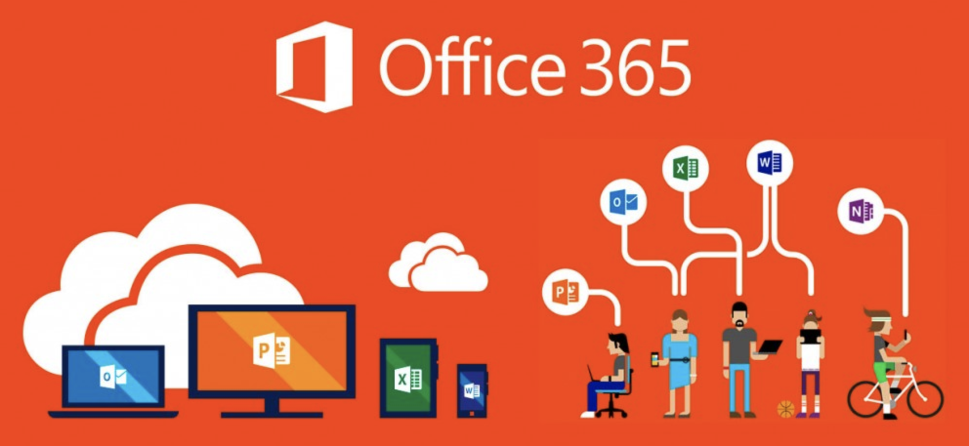
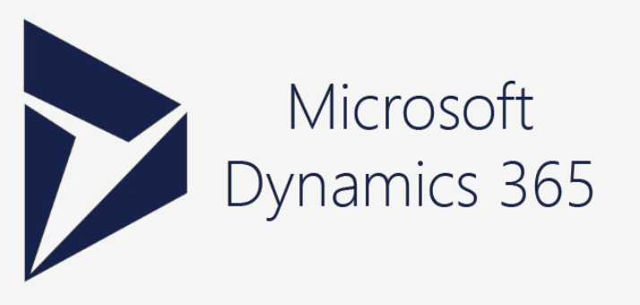
Microsoft Cloud Services
Collection of Integrated Cloud Services
Microsoft Office Suite Software over the Cloud
Cloud ERP & CRM Solution , Includes total of 11+ Apps

Slide 9
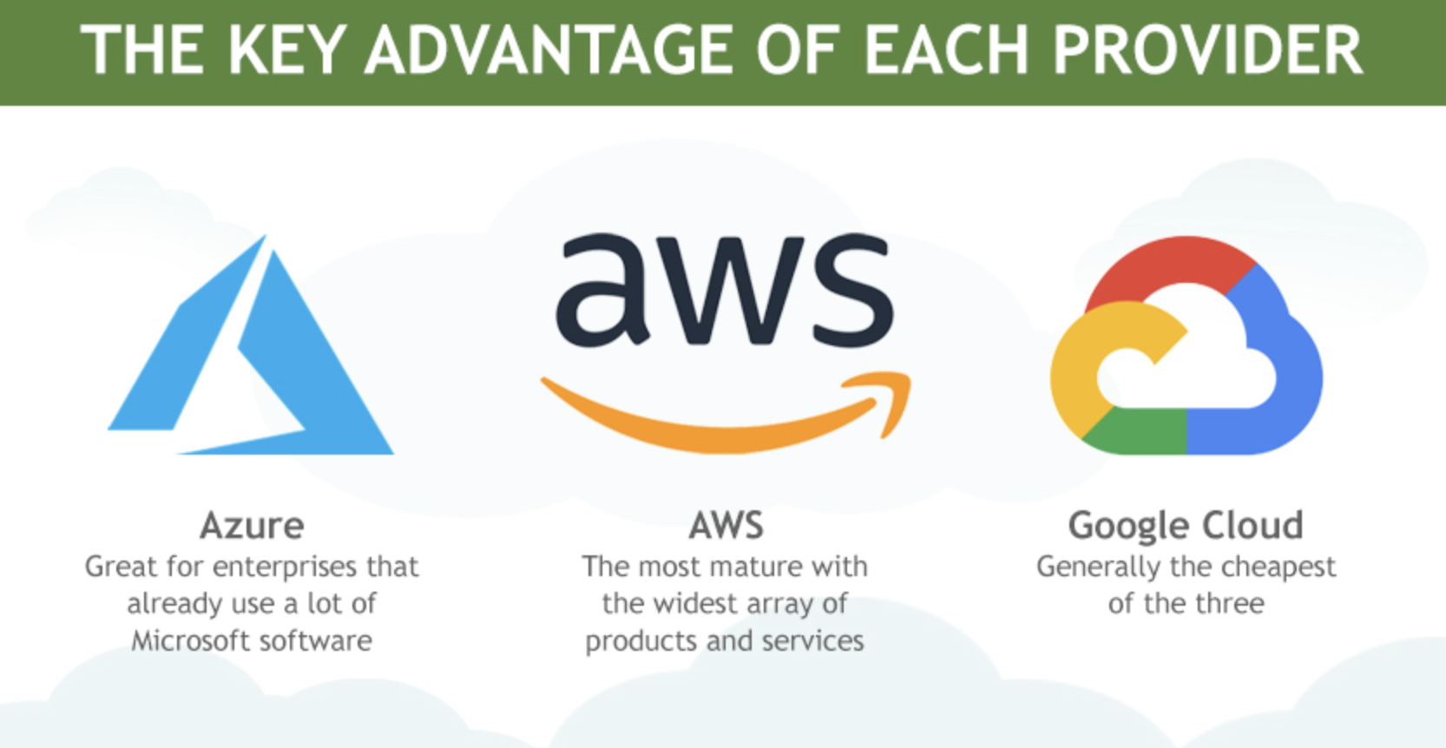
Which Cloud is Best

Slide 10
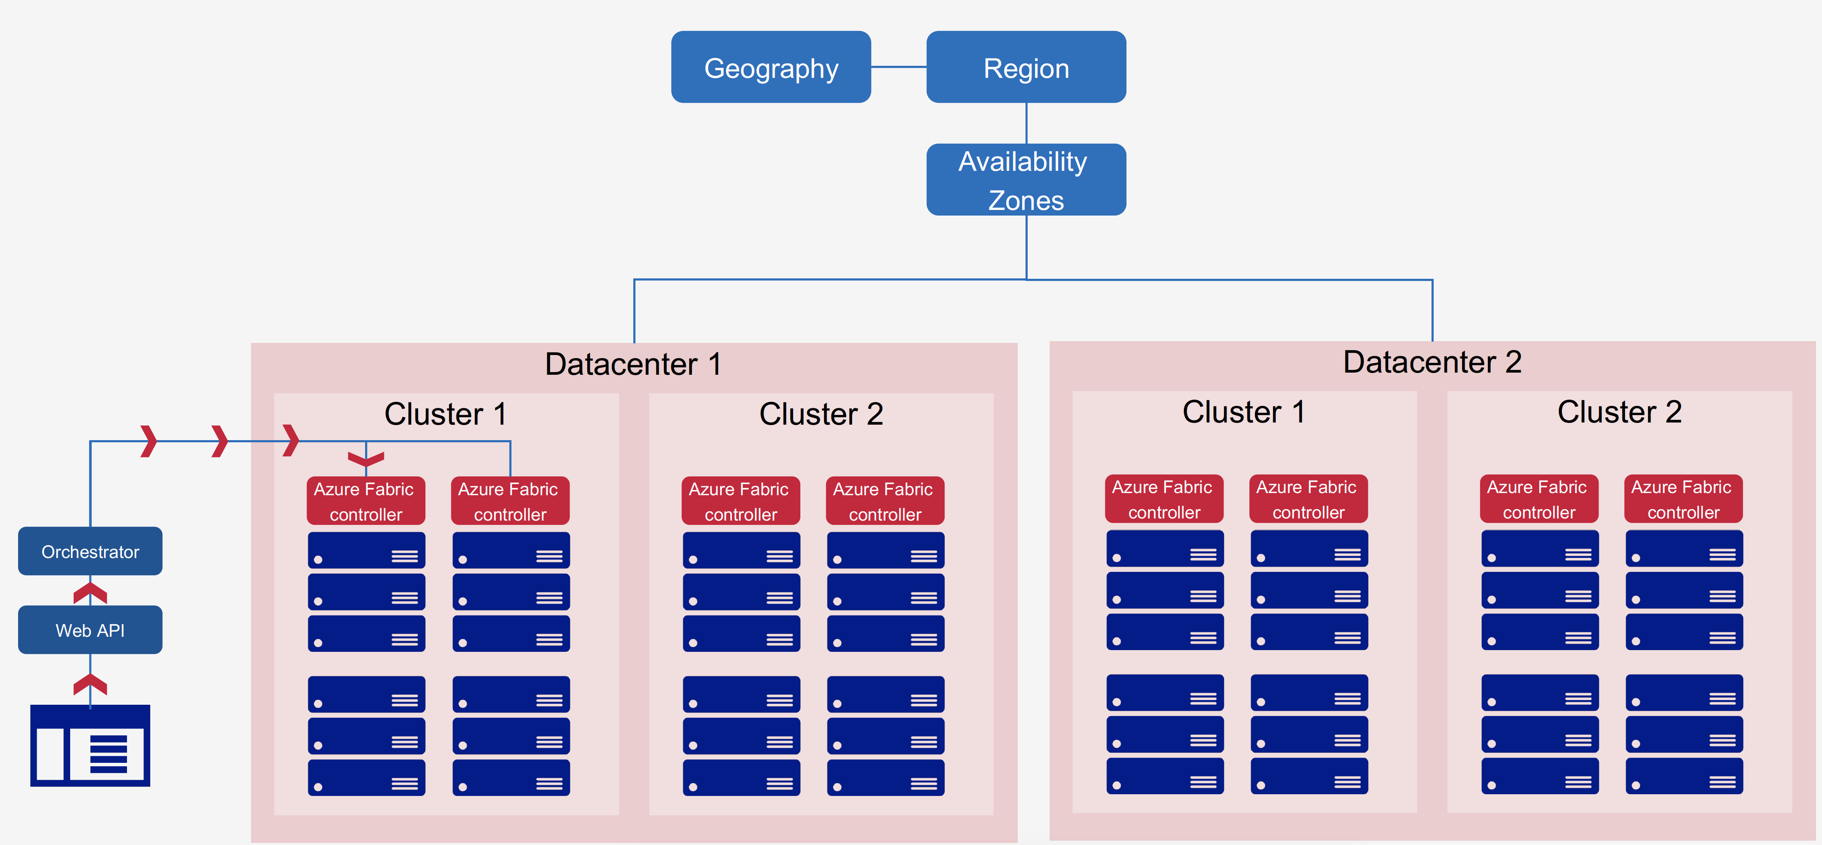
Azure Overview
Azure is over expanding Cloud Service Provider with over
100+ End to End Services
54 Global Azure Regions (42 current, 12 in Pipeline)
70 Compliance Offerings
90% fortune 500 Companies using Microsoft Cloud.
1. Geography – A Place with 2 or more Regions that preserves Data Resistency & Compliance Boundaries.
2. Region – region is a set of data centres deployed within a latency-defined perimeter and connected
through a dedicated regional low-latency network.
3. Availability Zones - physically separate locations within an Azure region. Each Availability Zone is made up of one or more data centres equipped with independent power, cooling and
networking.
https://azure.microsoft.com/en-us/global-infrastructure/regions/
http://www.azurespeed.com/Information/AzureRegions

Slide 11
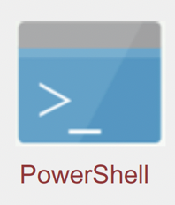

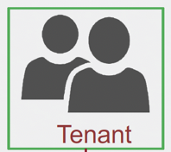
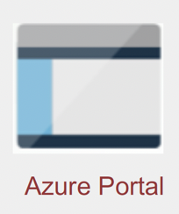

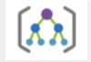

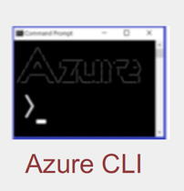
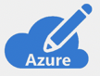


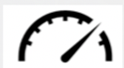


UNDERSTANDING AZURE
AZURE RESOURCE MANAGER (API)
(Manage/Deploy Resources, Authenticate, Authorize using AD)
TRUST
AZURE AD
BASED ON API REQ , DELIGATED TO PARTICULAR RP
RESOURCE PROVIDERS
MANAGEMENT GROUP (Enterprise Level)
Governance Levels
For all Subscriptions
RBAC
AZURE SUBSCRIPTION
Resource
Policies
RESOURCE GROUP
Resource
Limits
Financial
Limits
RESOURCE

Slide 12
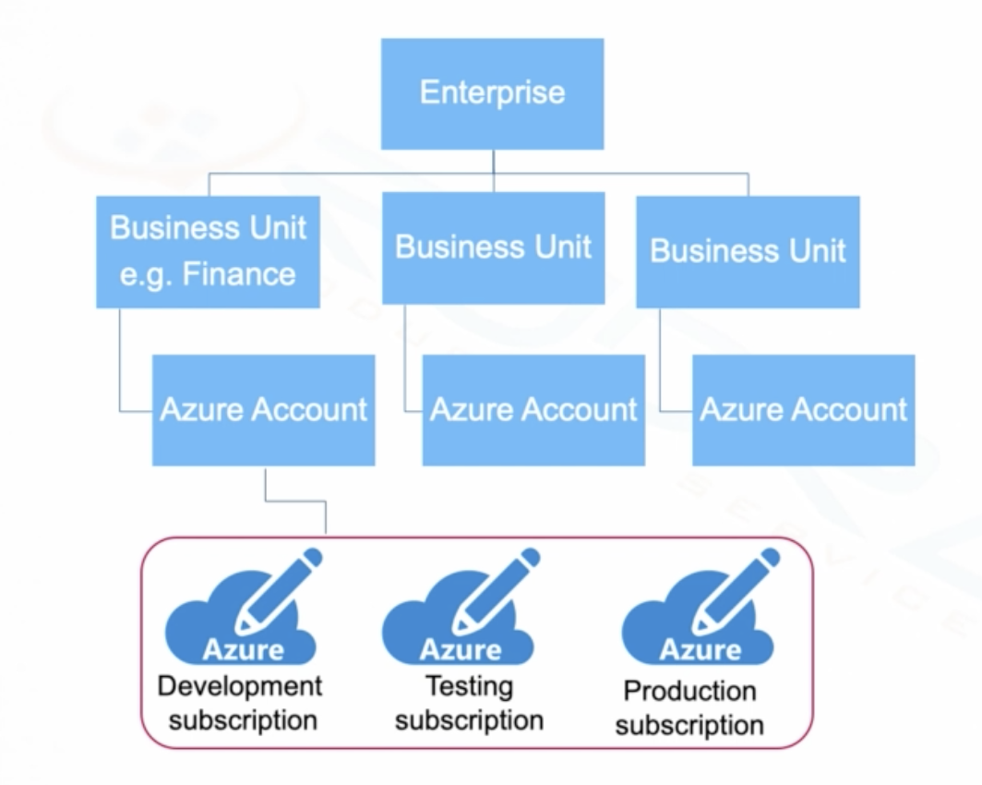
AZURE HIERARCHY
Top Level Enterprise Portal --> Create BU’s Like Finance , HR, Operations etc.
Create Azure Accounts, Dedicated AD Tenants for Finance & same for HR and Ops also.
Create Subscriptions under tenants

Slide 13
Azure 10,000 ft Overview
MANAGEMENT TOOLS
APPLICATION INSIGHTS
AUTOMATION
DEVELOPER TOOLS
REST APIs
STORAGE EXPLORER & EMULATOR
BILLING
AZURE MONITOR
LOG ANALYTICS
ADVISOR
NETWORK WATCHER
VISUAL STUDIO
AZURE POWERSHELL
CLI
ARM TEMPLATES
SCHEDULER
SECURITY
AZURE B2C
AZURE MFA
AZURE WAF
IoT
IoT Central
IoT Hub
Event Hubs
Notification Hubs
IoT Edge
AZURE AD
KEY VAULT
Security Center
RBAC
EAI
Service Bus
BizTalk Services
Logic Apps
Event Grid
ANALYTICS
Data Like Analytics
Stream Analytics
Power BI
APP SERVICES
Media Services
API Management
CDN
HD INSIGHT
MACHINE Learning
Cognitive Services
Notifications
Web Apps
Logic Apps
API Apps
SEARCH
Data Explorer
DATABASES
Redis Cache
Data Factory
DMS
SQL Server on VM
COMPUTE
Virtual Machine Scale Sets
Functions
SAP Hana
SQL DB
SQL DW
SQL SD
Cosmos DB
Azure DB for
Virtual Machine
CLOUD Service
Service Fabric
BATCH
CYCLE CLOUD
NETWORK
VNet
Load Balancer
Application Gateway
Traffic Manager
Express
Route
VPN
DNS
Firewall
Virtual WAN
DDoS
STORAGE
BLOB
TABLE
QUEUE
FILE
DISK
DATA LAKE STORAGE
DATABOX
STOR SIMPLE
STORAGE EXPLORER
ARCHIVE

Slide 14
Features not Covered in Overview
Site Recovery
Azure Backups
Microsoft Azure Trust Center
Compliance Manager
Microsoft Privacy Manager
Service Principles
Azure Information Protection Plan.

Slide 15
1. AZURE STORAGE
ID | Component | Purpose
1 | BLOB | Azure Blob Storage. Azure Blob Storage is a service for storing large amounts of unstructured object data, such as text or binary data. Common uses of Blob Storage include: Serving images or documents directly to a browser. Storing files for distributed access.
2 | TABLE | Azure Table storage stores large amounts of structured data. The service is a NoSQL datastore which accepts authenticated calls from inside and outside the Azure cloud. Azure tables are ideal for storing structured, non-relational data.
3 | QUEUE | Queue Storage is an Azure Service that enables you to put messages on the queue and asynchronously process these messages. Therefore Queue Storage is an ideal method to process events that don't require a specific order.
4 | FILE | Simple, secure and fully managed cloud file shares Extend your servers to Azure with Sync for on-premises performance and capability Secure data at rest and in-transit using SMB 3.0 and HTTPS Simplify cloud file share management using familiar tools Create high-performance file shares using the Premium Files storage tier
5 | DISK | An Azure managed disk is a virtual hard disk (VHD). You can think of it like a physical disk in an on-premises server but, virtualized. Azure managed disks are stored as page blobs, which are a random IO storage object in Azure.
6 | Data Like Storage | Data Lake Storage Gen2 makes Azure Storage the foundation for building enterprise data lakes on Azure. Designed from the start to service multiple petabytes of information while sustaining hundreds of gigabits of throughput, Data Lake Storage Gen2 allows you to easily manage massive amounts of data.
7 | Data Box | Like Snowball in AWS, If we have to xfer Huge Data to Azure , We can request for Data Box and transfer the files to that and ship it Microsoft.
8 | StorSimple | Microsoft Azure StorSimple, an integrated storage solution that manages storage tasks between on-premises devices and Microsoft AZURE cloud storage. Moreover, StorSimple uses deduplication and compression to reduce the amount of storage that the data consumes.
9 | Storage Explorer | It’s a Piece of Client Software to access all the Storage Services in Azure
10 | Archive | Azure Archive Blob Storage. Azure Archive Blob storage is designed to provide organizations with a low cost means of delivering durable, highly available, secure cloud storage for rarely accessed data with flexible latency requirements (on the order of hours)

Slide 16
2. AZURE Network
ID | Component | Purpose
1 | VNet | VNet Service Endpoints enable you to isolate connectivity to your logical server from a given subnet or set of subnets within your virtual network. The traffic to Azure SQL Data Warehouse from your VNet will always stay within the Azure backbone network.
2 | Load balancer | With Azure Load Balancer, you can scale your applications and create high availability for your services. Load Balancer supports inbound and outbound scenarios, provides low latency and high throughput, and scales up to millions of flows for all TCP and UDP applications.
3 | Application Gateway | Azure Application Gateway is a web traffic load balancer that enables you to manage traffic to your web applications. This is based on Layer 7 Load Balancing
4 | Traffic Manager
5 | Express Route
6 | VPN
7 | DNS
8 | Firewall
9 | Virtual WAN
10 | DDoS

Slide 17
3. AZURE COMPUTE
ID | Component | Purpose
1 | Virtual Machine
2 | Cloud Service
3 | Service Fabric
4 | Batch
5 | Cycle Cloud
6 | SAP Hana
7 | Functions
8 | Virtual Machine scale sets

Slide 18
4. AZURE DATABASES
ID | Component | Purpose
1 | Redis Cache
2 | Data Factory
3 | DMS
4 | SQL Server on VM
5 | SQL DB
6 | SQL DW
7 | SQL SD
8 | Cosmos DB
9 | Azure DB for

Slide 19
5. AZURE ANALYTICS
ID | Component | Purpose
1 | Data Lake Analytics
2 | Stream Analytics
3 | Power BI Embedded
4 | HD insight
5 | Machine Learning
6 | Cognitive Services
7 | Data Explorer

Slide 20
6. AZURE APP Services
ID | Component | Purpose
1 | CDN
2 | Media Services
3 | API Management
4 | Notifications
5 | Web Apps
6 | Mobile Apps
7 | Logic Apps
8 | API Apps
9 | Search

Slide 21
7. EAI
ID | Component | Purpose
1 | Service Bus
2 | Biztalk Services
3 | Logic Apps
4 | Event Grid

Slide 22
8. IoT
ID | Component | Purpose
1 | IoT Central
2 | IoT Hub
3 | Event Hubs
4 | Notification Hubs
5 | IoT Edge

Slide 23
9. Management Tools
ID | Component | Purpose
1 | Application Insights
2 | Automation
3 | Billing
4 | Cost Management
5 | Azure Monitor
6 | Log Analytics
7 | Advisor
8 | Network Watcher
9 | Scheduler

Slide 24
10. Developer Tools
ID | Component | Purpose
1 | REST APIs
2 | Storage Explorer & Emulator
3 | Visual Studio
4 | Azure PowerShell
5 | CLI
6 | ARM Templates

Slide 25
Important for the exam

Slide 26
Important Links and References
Azure Documentation - https://docs.microsoft.com/en-gb/azure/
Azure Portal – https://portal.azure.com/

